Slide 1

BA Seminar sS 2022 Elektronik und Computer Engineering Florian Zwittnigg
Determining the internal resistance of a lithium ion battery

Slide 2
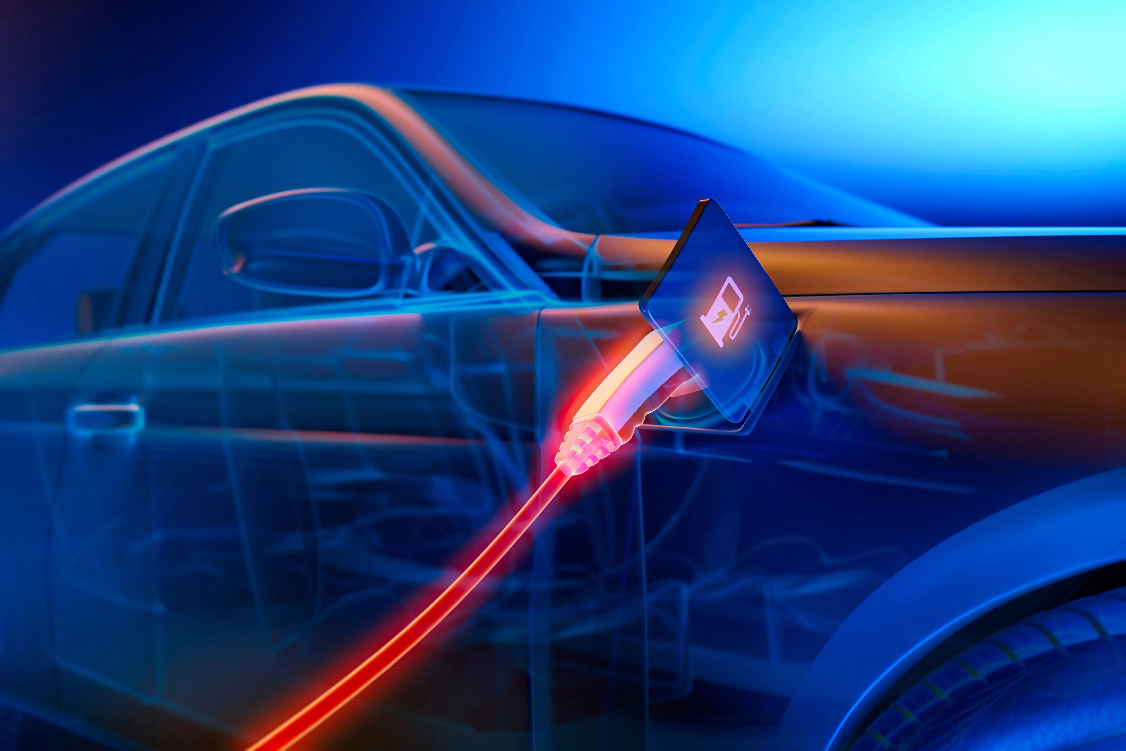

Motivation
Condition of a Lithium Ion Battery
Information about durability of the Battery
Simple and fast measurement

Slide 3
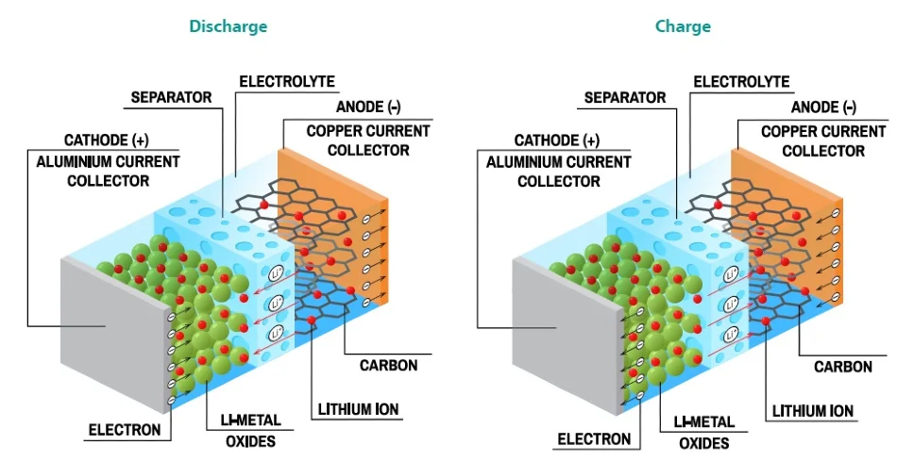
Lithium Ion Battery general information
Build of a Lithium Ion Battery
Aging Process
Meaning of the internal resistance
https://www.azom.com/article.aspx?ArticleID=19013

Slide 4
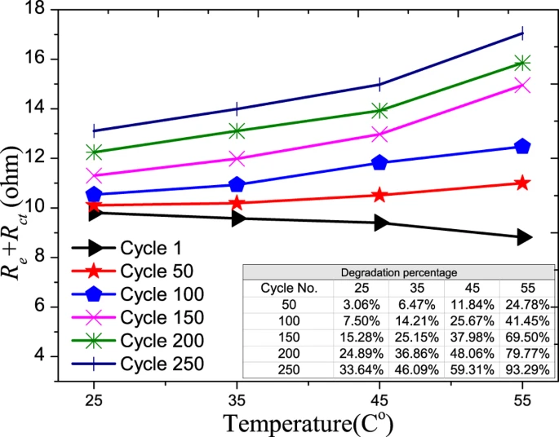
Lithium Ion Battery general information
Aging Process
https://www.nature.com/articles/srep12967

Slide 5
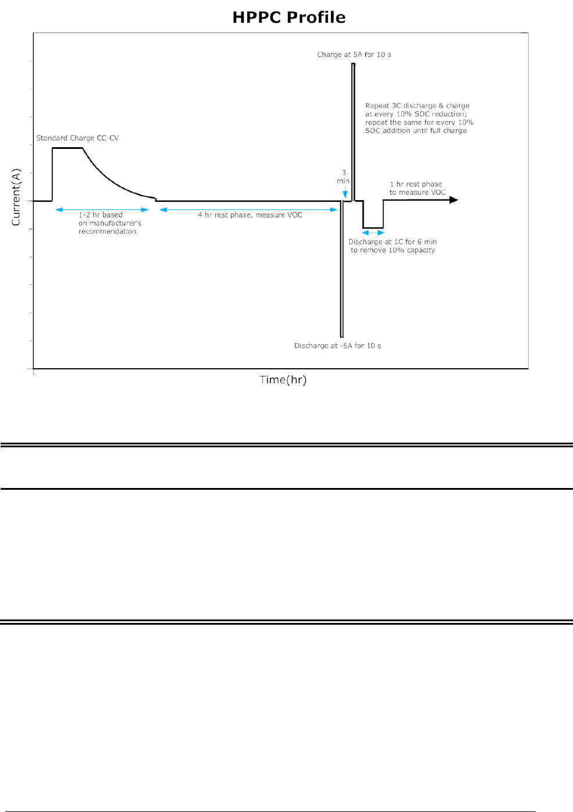
Methods to determine the internal resistance of a Lithium Ion battery
Hybrid Pulse Power Characterization (HPPC)
https://www.researchgate.net/figure/Hybrid-Pulse-Power-Characterization-HPPC-test-profile_fig2_235602059

Slide 6
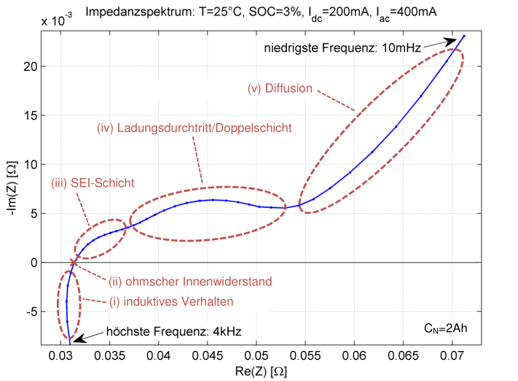
Methods to determine the internal resistance of a Lithium Ion battery
Galvanostatic Intermittent Titration Technique (GITT)
Electrochemical Impedance Spectroscopy (EIS)
https://mediatum.ub.tum.de/doc/1162416/

Slide 7
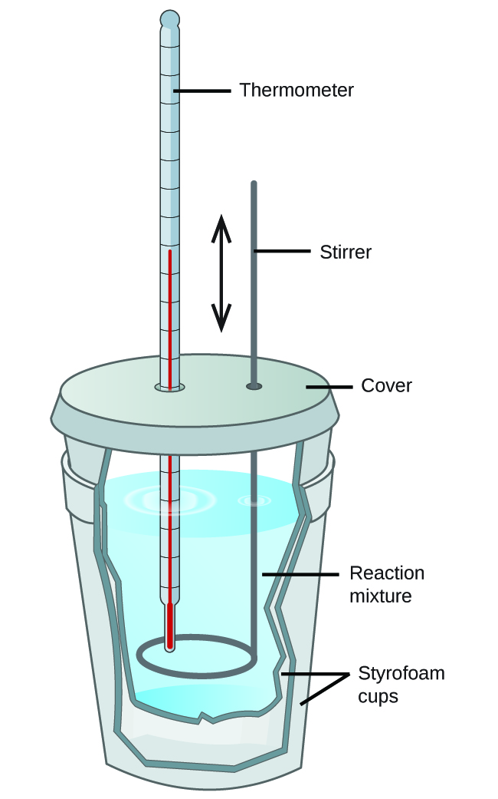
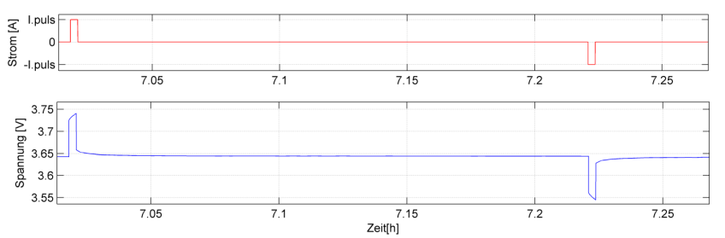
Methods to determine the internal resistance of a Lithium Ion battery
Calorimetric Measurement
DC Charging Method
Parameterization using current pulses
https://mediatum.ub.tum.de/doc/1162416/1162416.pdf
https://opentextbc.ca/chemistry/chapter/5-2-calorimetry/

Slide 8
Findings
„The internal total resistance represents the sum of the individual resistances in the SEI-layer, the charge passage and the diffusion in equilibrium“ (https://mediatum.ub.tum.de/doc/1162416/1162416.pdf, Page 9)
And determines the ability how much current can be delivered by the battery
Battery is aging → resistance is increasing (https://www.nature.com/articles/srep12967)

Slide 9
Findings
Chosen method is the parameterization using current pulses
Already used with the existing device from the company
In comparison to other methods not time consuming
Advantage: fast and easy measurement
Disadvantage: not as accurate as the other methods
Other measurements are much more complex or take to much time respectively need expensive measuring devices

Slide 10
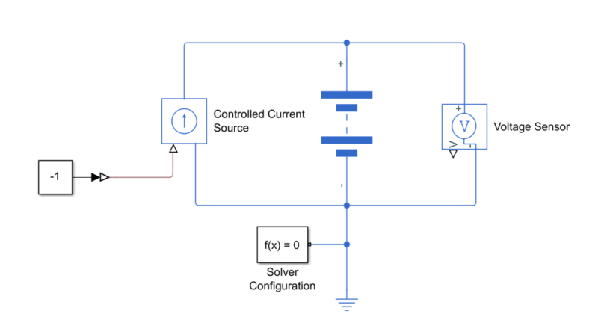
Outlook
Model building in Simulink
Equivalent electric circuit to reality
Data Evaluation of the system response
Comparison of the results with the findings from the literature

Slide 11
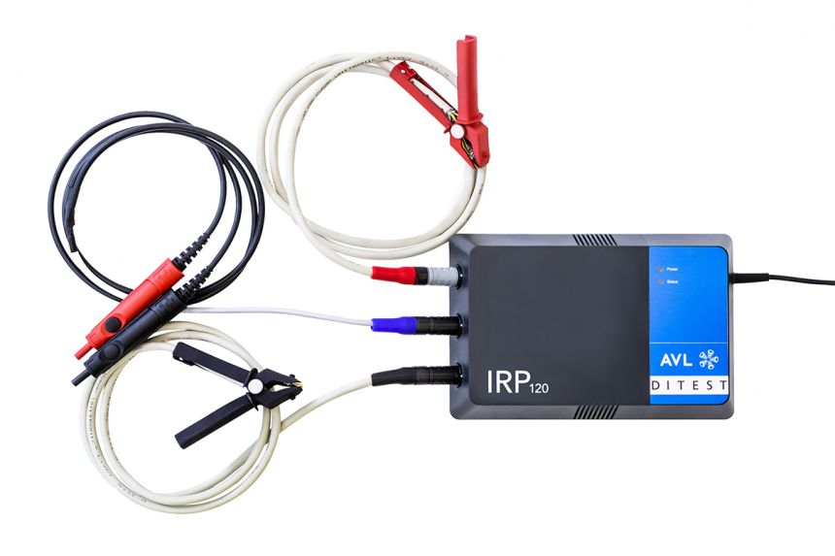
Outlook
Measurements with available hardware
Device IRP120
Measurement of 400V System
Measurement of single cells
Comparison between Matlab results and measurement results

